Slide 1
Part 1: Introduction to NVivo
Alex Shermon | Research Computing Services

Slide 2
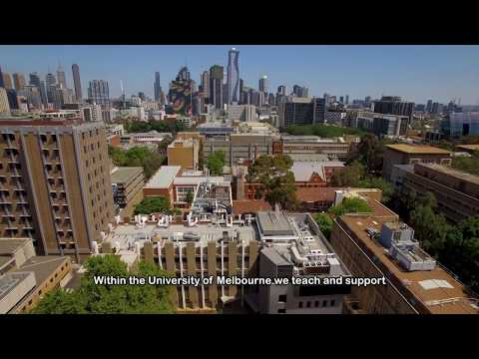
Welcome to Research Computing Services!

Slide 3
Digital Support Packs
During this time, we’ve moved our face to face training online.
Our trainings are now shorter, and are accompanied with an online learning lab.
This lab will help guide you through today’s training, and contains extra resources to help you learn NVivo!

Slide 4
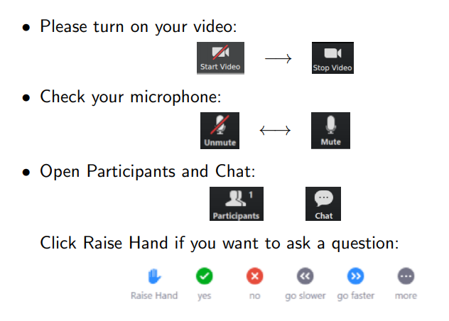
Zoom Etiquette

Slide 5
About Me
Masters of Global Media Communications Student
Omeka and NVivo Research Community Coordinator
Research Assistant on some neat archival projects
Playing SO MUCH Dungeons and Dragons right now

Slide 6
Today’s Learning Objectives
This workshop will teach you the fundamental building blocks of NVivo: Coding and file management
By the end of this workshop you will understand how to:
Navigate NVivo’s user interface
Import Files
Create Nodes
Code Textual Data

Slide 7
Getting Started

Slide 8
Qualitative Research
Lisa Given (2008)
Exploring the “human elements” of a given topic
“Typically used to explore new phenomena and to capture individuals’ thoughts, feelings, or interpretations of meaning and process”
Your Research Question is fundamental!

Slide 9
2. What is NVivo?

Slide 10
A Brief History of NVivo
Created at La Trobe University in the 80s by Lyn and Tom Richards.
Originally called NUD*IST
Renamed to N
NVivo launched in 2002 along N6
NVivo 1.0 launched in March 2020
We’re using NVivo 12!

Slide 11
What is NVivo?
Computer Assisted Qualitative Data Analysis Software (CAQDAS)
Designed to assist qualitative and mixed methods researchers
Three key functionalities:
Import
Organise
Explore

Slide 12
Disclaimers
NVivo looks different on Mac than it does on PC - I do not own a Mac (yet)!
NVivo does not do your research for you!
Research with NVivo takes time

Slide 13
3. Why use NVivo? Case Studies

Slide 14
My Research Project
I used NVivo to conduct a critical discourse analysis of conservative newspaper opinion editorials
I used NODES to code THEMES
I used CASES to code AUTHORS
I used VISUALISATIONS to compare and contrast THEMES across AUTHORS

Slide 15
Literature Reviews (Throughout this Course)
You can conduct a literature review in NVivo
Import your reference library (Part 1 and Part 5)
Organise your reading list (Part 3)
Write up annotations and memos of your critical reflections on this literature (Part 3)
Thematically analyse your critical reflections (Part 1)

Slide 16
Researching with Interviews - Our Sample Project
Interviews are the dataset that I will be using in my demonstrations today.
Our research question will be = what do these interviewees have to say about the water system in their local area and does this differ across demographic attributes?
Today, we will be importing our interview transcripts, and beginning the process of coding a thematic analysis.
In future sessions, we will look at exploring the differences between demographic attributes of our interviewees - such as their age and occupation

Slide 17
4. Importing Files in NVivo

Slide 18
What Files can NVivo Import?
NVivo can import loads of different files types:
Text documents (Word, pdfs, txt.)
Audio files
Images
Reference data from Zotero, Endnote
Survey data
Twitter data

Slide 19
For our Research Project
We have done a round of interviews.
I want to import those interviews into NVivo, and organise them into a folder.

Slide 20
Demo: Importing Files
In this demo, I’m going to show you:
What NVivo’s interface looks like and how it works
How to create a file folder
How to import files into NVivo

Slide 21
Challenge 1: Importing Files into NVivo
This is stuff that YOU get to do:
Create a blank project in NVivo
Create a folder for your files in NVivo
Import files into NVivo
Sample files: http://go.unimelb.edu.au/8i3r

Slide 22
5. Coding Files in NVivo

Slide 23
What is Coding?
Coding is the procedure by which researchers transform recorded data into theoretically meaningful categories.
Coding is stored in Nodes in NVivo (very confusing)
Think of “Nodes” as “Containers”
Lots of different types of coding in NVivo, but today we’ll be focusing on the most common area: Nodes

Slide 24
For our Research Project
Now that I have imported my interview transcripts, I want to begin to explore the themes that emerge from a cursory examination of the text.

Slide 25
Demo: Coding in NVivo
In this demo, I’ll show you two ways to code in NVivo
The hard way
The easy way
I’ll show you how to create nodes, and to move text into them

Slide 26
Challenge: Coding in NVivo
Create a node via the two ways I showed you in the demo
Code sections of the text into nodes
Bonus task: Try to uncode from your nodes

Slide 27
Wrapping up
This workshop has hopefully introduced you to the basics of NVivo
You should know how to:
Navigate NVivo’s user interface
Import files
Create nodes
Code textual data

Slide 28
Next Steps - Join the Community!
In Part 2: We’ll learn the various other ways of coding in NVivo
Join the Facebook group if you have any questions: https://www.facebook.com/groups/unimelbnvivo
Please fill in the feedback form:
Make sure to check out the GitBook for extra helpful resources:http://go.unimelb.edu.au/2i3r
Want to become a ResLead? Get in touch with me at alex.shermon@unimelb.edu.au

Slide 29
Any Questions?

